Slide 1
AIR QUALITY ASSESSMENT TAMILNADU
PROBLEM STATEMENT
DEFINITION
DESIGN THINKING
INNOVATION

Slide 2
PROBLEM STATEMENT: The project aims to analyze and visualize air quality data from monitoring stations in Tamil Nadu. The objective is to gain insights into air pollution trends, identify areas with high pollution levels, and develop a predictive model to estimate RSPM/PM10 levels based on SO2 and NO2 levels. This project involves defining objectives, designing the analysis approach, selecting visualization techniques, and creating a predictive model using Python and relevant libraries.
UNDERSTANDING A PROBLEM: The project aims to analyze and visualize air quality data from monitoring stations in Tamil Nadu. The objective is to gain insights into air pollution trends, identify areas with high pollution levels, and develop a predictive model to estimate RSPM/PM10 levels based on SO2 and NO2 levels. This project involves defining objectives, designing the analysis approach, selecting visualization techniques, and creating a predictive model using Python and relevant libraries.

Slide 3
AIR QUALITY TRERNDS
POLLUTION HOTSPOTS
The air quality in Chennai city has been monitored over many years by Tamil Nadu Pollution Control Board (TNPCB) as well as independent academic institutes like IIT Madras. During these studies the levels of the gaseous pollutants NOx, SOx and the levels of particulate matter PM10 have been recorded.
14 (PM2.5)
38 (PM10)
3 (SO2)
325 (CO)
5 (Ozone)
7 (NO2)
CHENNAI
COIMBATORE
CONJEEVARAM
CUDDALORE
ETC

Slide 4
DESIGN THINKING
To develop a app to monitor and analyze the air quality in your respective areas and places.
The app claims to offer all the information about air quality in one place.
The app promises to offer real-time data about air pollution.
The app also offers live street-by-street pollution maps of all the areas.
The app also offers detailed information about how the air quality will evolve and change in the next 72 hours.
You can also take images of a particular location via the app and they can be shared.
The app also warns users about any open fire that may occur close to them in real time.
The air quality app gives individual statuses of all outdoor air pollutants like PM10,PM2.5,CO,NO2,SO2.
The app claims to reduce your exposure to bad air quality and pollen.
The app uses machine learning and artificial intelligence to provide the most accurate real time, street level quality and pollen data.
You can also check the live AQI level on Google Maps using the app.

Slide 5
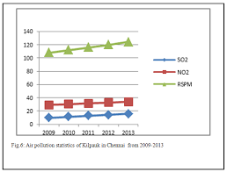
VISUALIZATION OF AIR QUALITY

Slide 6
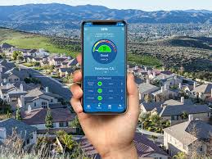
APP TO BE DEVELOPED(SAMPLE)

